Slide 1
Unit 2.2 – Plate Tectonics
EQ1: How was scientific evidence used to come up with the Theory of Plate Tectonics, and has the theory become widely accepted by scientists?
EQ2: How can we use observational evidence to predict plate boundaries and the motion of tectonic plates?

Slide 2
The Theory of Plate Tectonics
2 types of crust:
Continental – very thick, not very dense
Oceanic – thinner and very dense
Lithosphere: outer shell of the earth including the crust and upper mantle; tectonic plates are found here
Asthenosphere: zone of the mantle below the lithosphere on which the plates “float”
The Asthenosphere and molten rock of the mantle below flow and therefore slowly force the Lithosphere crust above it to move

Slide 3
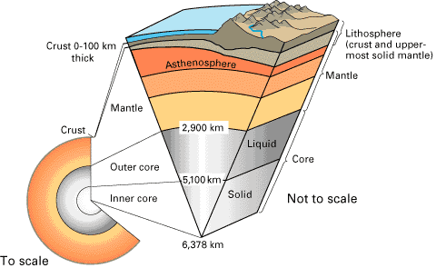
Layers of the Earth

Slide 4
The Theory of Continental Drift
Video: http://www.youtube.com/watch?v=nbU809Cyrao
Alfred Wegener, was the first to propose
Continenetal Drift
What first gave him the idea that the continents move (drift)?
Continents look like they fit in a puzzle
What additional evidence did Wegener find to support his theory?
fossils, rock formations, and similar Mts. OS. America → africa and N. america → Europe

Slide 5
The Theory of Continental Drift
What was the conclusive evidence that supported Wegener’s hypothesis, discovered decades after his death?
Evidence of sea floor spreading

Slide 6
Seafloor Spreading and Renewal of the Ocean Floor
Video: http://www.youtube.com/watch?v=6CsTTmvX6mc
What did people believe the sea floor looked like before WWII when Harry Hess mapped the sea floor.
Flat
What does it actually look like?
Mountainous
The mountain range in the middle of the atlantic ocean is called the __Mid-Atlantic ridge

Slide 7
What did Harry Hess discover when he analyzed core samples from the floor of the Atlantic Ocean?
Ridges & mts.
Age of rock increased as you move away from the ridge
Hess called the idea of the atlantic ocean spreading _Sea-floor Spreading
If seafloor is created in one place, what must happen somewhere else?
Be destroyed→ subduction

Slide 8
Evidence of Seafloor Spreading
Read the “Evidence of Seafloor Spreading” section, and summarize in 2-3 sentences the evidence of seafloor spreading.
Magnetic anomalies (changes) recorded in the crust showing how the magnetic field fluctuated over time

Slide 9
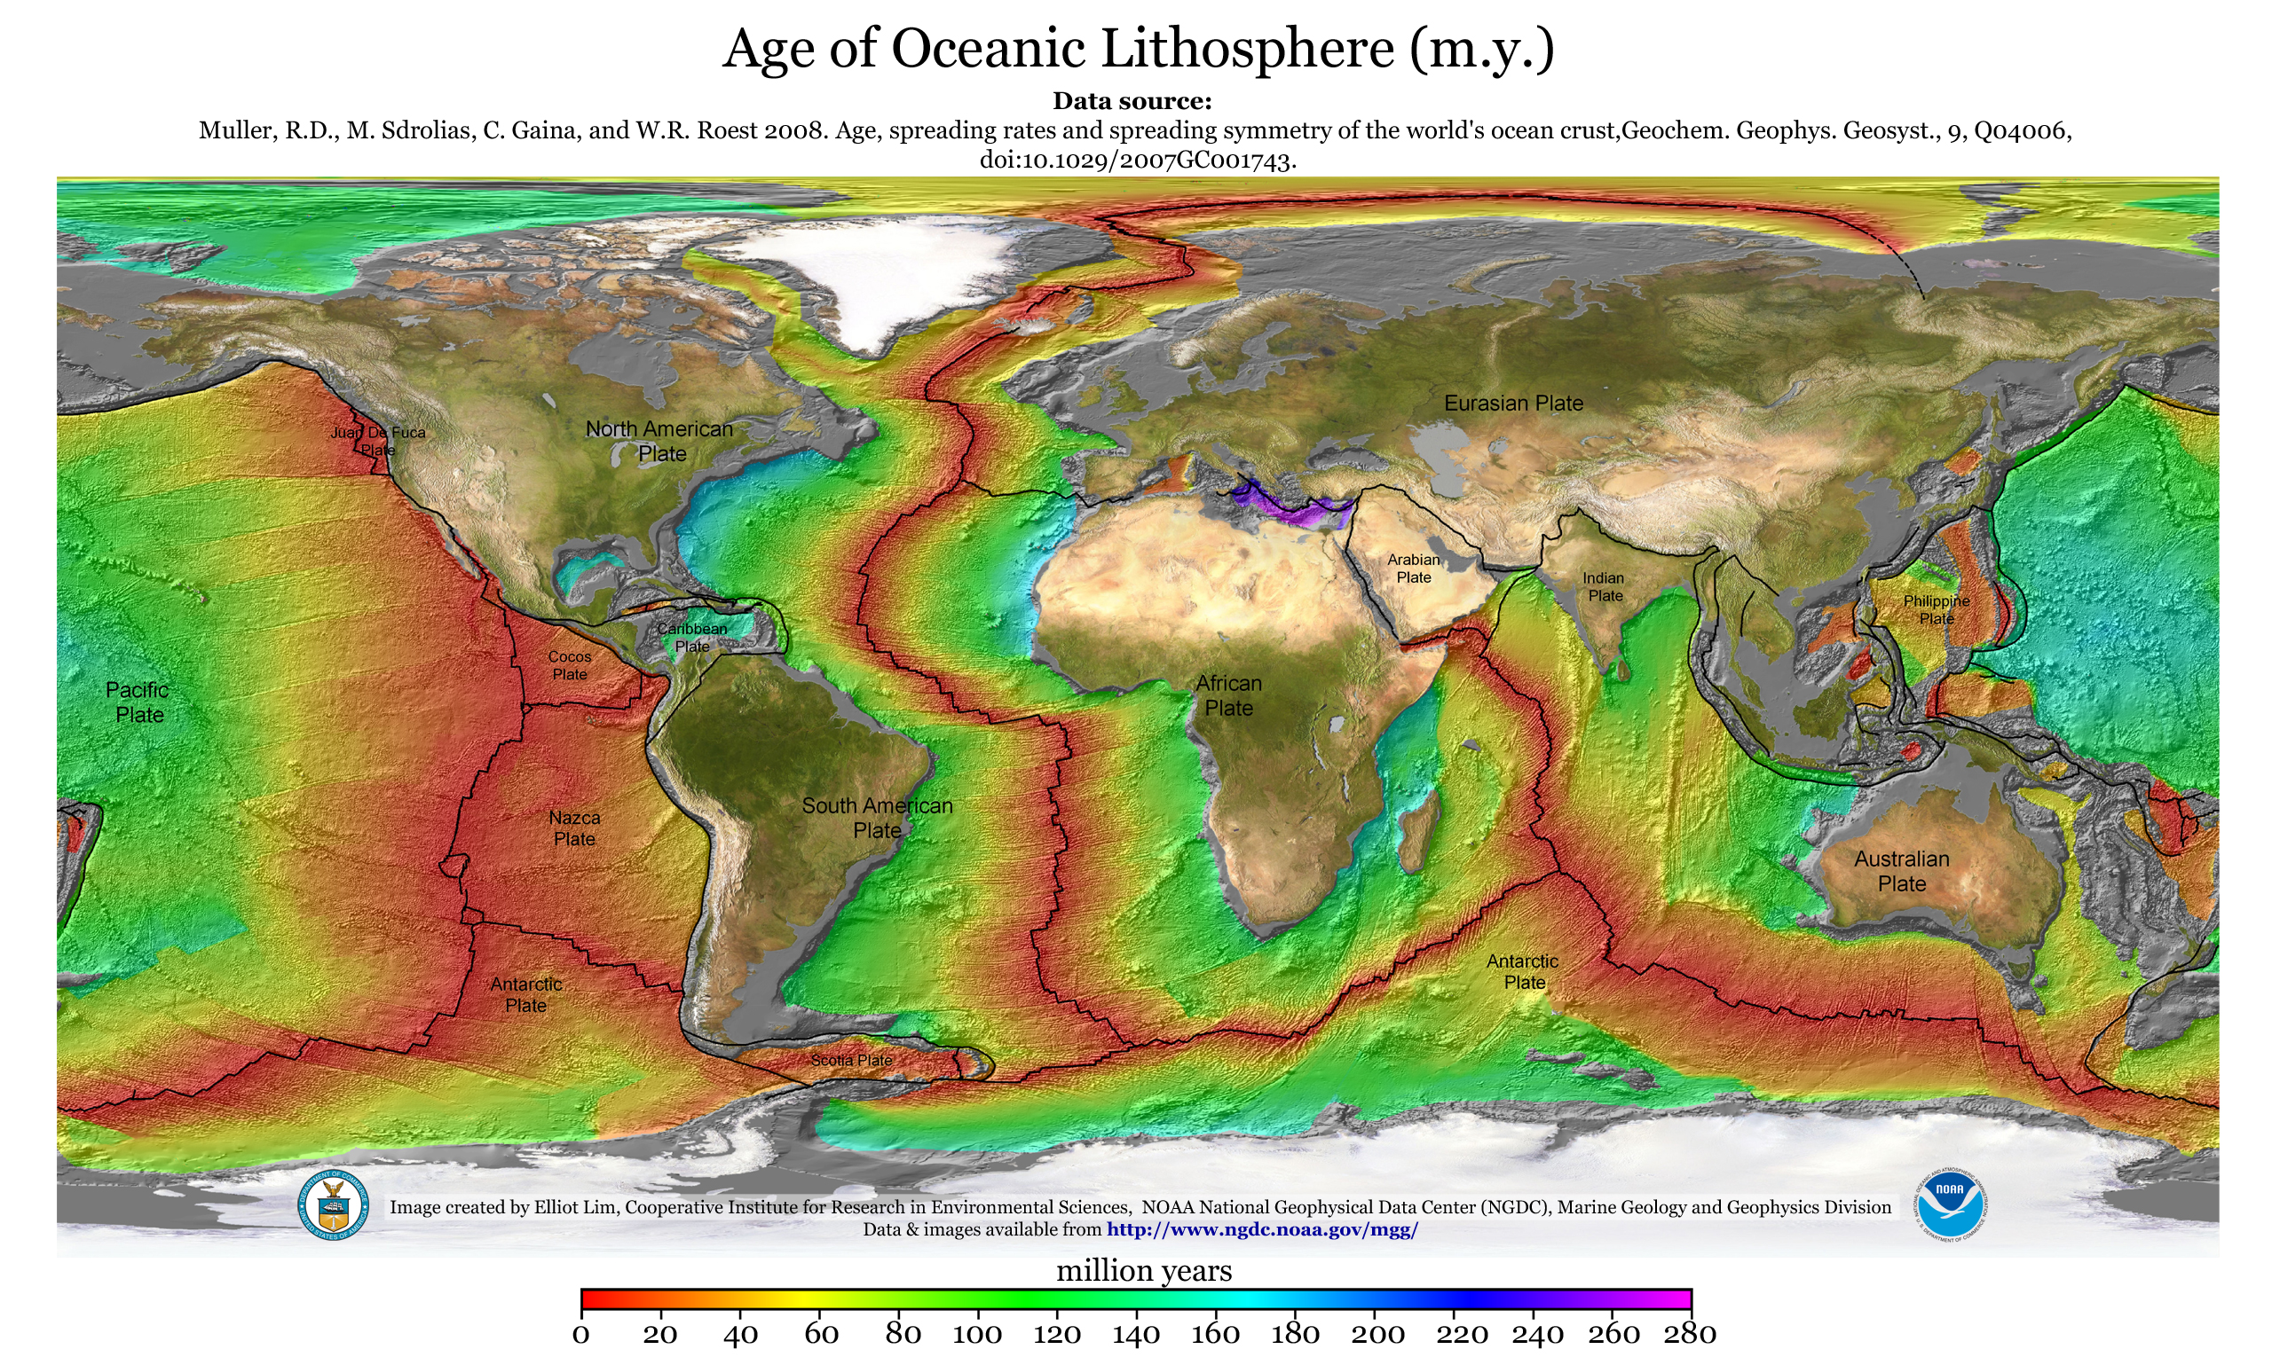

Slide 10
Review (part 1)
The Theory of Continental Drift:
First proposed by Alfred Wegener
States that the continents are not static and in fact are moving in relation to each other
The Theory of Seafloor Spreading:
Proposed by Harry Hess after he noticed giant mountain ranges and rift valleys under the Ocean.
This states that as the plates move apart, magma comes up at the point they separate and solidifies creating new crust.

Slide 11
What makes the plates move?
Currents within the mantle, similar to those in the ocean, pull the crust in different directions.
The mechanism causing these currents is called ____Convection

Slide 12
Convection Currents
Look at the setup on the front table, what do you notice?
Lava lamp
What mechanism do you think is causing this to happen?
convection
How does this relate to the movement of the magma in the mantle?
Heat from core heats magma which rises to crust, cools and falls → convection current

Slide 13
Types of plate boundaries
There are 3 types of lithospheric plate boundaries:
__Convergent__ boundaries are when the plates are moving together.
_divergent_ boundaries are when the plates are moving apart.
__transform_ boundaries are when the plates are sliding past each other.

